Slide 1






Slide 2

About Us
SEASWAN SHIPPING & LOGISTICS (SSSL) a company launched in 2015 offering our expertise in the area of Total Logistics solutions covering a gamut of services like International Freight Forwarding both by Air and Sea, Custom Clearance and personalized value added services to our valued customers.
We are focused on developing a strong international connection around the globe.
We found the importance to venture into the requirements of our customer base and embarked to provide prioritized logistics solutions, focusing on personalized, time bound, efficient and economical services to our valuable customers based on effective and responsive operation.

Slide 3
We have optimized all logistical instruments such as,Consolidation,FreightForwarding,
Documentation,
Customs Clearance, Shipping and Trucking, supported located nationally and internationally.
We commit to cover our services globally and provide a personalized, professional and extra mile services to our customers.

Slide 4

Vision
SSSL Provide an excellent ‘Priority Services by Professionals” that satisfies all the needs. It is our vision to be the most preferred total logistics solution provider under one roof to customers.

Slide 5

Services
Freight Forwarding by Air, Sea, Land
Door to Door Service (DDP, DDU)
Customs Clearance
Warehousing & Distribution
Transportation
Consultation Service
Value Added Services
LCL Consolidation

Slide 6

Freight Forwarding
The best and premier combination of both Air and Sea forwarding are used to provide our customers with the fastest, most economical and reliable freight forwarding services.
Liasioning for, booking, survey, documentation, tracking and comprehensive door-to-door services for both In-bound and Out-bound.
We provide a complete reporting of the status at each stage.

Slide 7
Customs Clearance/Broking — Export
We provide Customs Clearance/Broking services for Exports.
We ensure that export shipments custom cleared on priority and hassle free transaction.
Our dedicated and well experienced team of work force will take the responsibility in collecting & preparing documents towards completion of customs formalities. Submission of the post clearance documentation to respective shipping line/air line/customer.
We provide the complete tracking and delivery information of the cargo at destination.
Customs Clearance/Broking — Import
We provide Customs Clearance/Broking services for Imports.
We ensure that import shipments custom cleared n priority and hassle free transaction.
Our dedicated and well experienced team of work force will take the responsibility in collecting preparing documents, submission to concerned customs authorities towards completion of customs formalities. Ensure the safe delivery of the cargo to the customer warehouse.
Timely clearance to avoid/minimize the detention and demurrage.

Slide 8
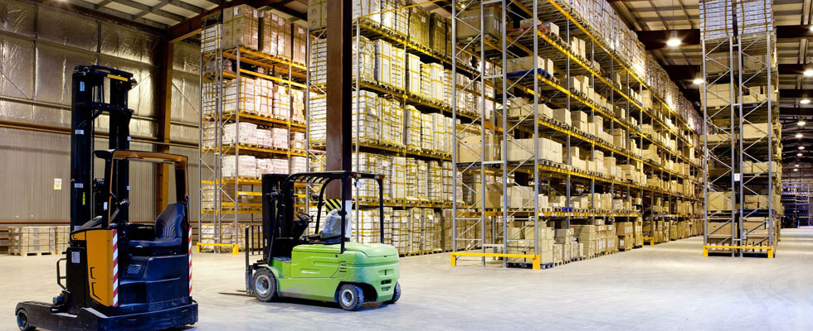
WAREHOUSING
We can arrange and Provide good, Secure and spacious and specific storage facilities for your cargo on rental pro rate basis as and when required .

Slide 9

DISTRIBUTION
Our Mission and Vision states for total Logistics solutions, we can provide efficient and committed distribution facility for your cargo as per the requirement.

Slide 10

Transportation
A very good association of Local and Muffasil movement vendors, we can offer time bound pickup and delivery facilities at any time which in turn helps in committed production/supply by our valued customers.

Slide 11

Door to door services
Worldwide network of agents can provide door pickup and door delivery services for cargo at any corner of the world.

Slide 12

Consultation service
Dedicated team of management having vast experience in the different industry verticals on the field of Total Logistics solution, Crisis Management, Administration Management, Liaison Management etc..,
SSSL can provide you not only
the on field service but also the
consultationservices to our
valued customers.
“Consultation to implement at
their premises an effective and economical Logistics management.”

Slide 13
Value added services
SSSL care for their customer facilitation under one roof, we provide Value added service like.
Analysis Report on each and every transaction with respect to time taken
Tracking and Reporting of the cargo till it reaches the destination
Timely clearance to avoid/minimize the demurrage/detention
RCA(Root Cause Analysis) in identifying the grey areas of every transaction there by helpful in future planning
Advise and obtaining different scheme benefits from JDGFT

Slide 14

Value added services
Duty Drawback from Customs
GSP from Export inspection Agency
Certificate of Origin from chamber of Industry & commerce
Phytosanitary Certificate from plant and Quarantine Department
Fumigation Services from licensed fumigation agents
Palletization & Lashing the cargo from experience agencies etc…,

Slide 15
Our strengths
Priority Services by Professionals
Experienced & Knowledgeable Team of Management
Service oriented and available to customers even during extended business hours
Vast of knowledge on Customs process or formalities
Excellent domain expertise in different industry verticals
Contracts with reliable Transporters to provide local & Muffasil movement facility
Good rapport with Direct shipping Lines/ Air lines/forwarders etc
Associate offices in the country
Worldwide agency network
Experienced & Dedicated team of work force for Documentation , Processing and completion of task.

Slide 16

Our strengths
“LAST BUT NOT THE LEAST WE WILL ASSURE OF OUR PERSONALIZED SERVICES AT ALL TIMES ON BEST LEVEL”

Slide 17

CONTACT US
CORPORATE OFFICE
SEASWAN SHIPPING & LOGISTICS
SMJ Moore Plaza, 3rd Floor
C3, 65/31, Moore Street,
George Town, Chennai – 600001
Mob : +91- 9677146643,9840091455.
MUMBAI OFFICE - BRANCH
TUTICORIN OFFICE - BRANCH
SEASWAN SHIPPING & LOGISTICS
SMJ Moore Plaza, 3rd Floor
C3, 65/31, Moore Street,
George Town, Chennai – 600001
Mob : +91- 9677146643,9840091455.
SEASWAN SHIPPING & LOGISTICS
SMJ Moore Plaza, 3rd Floor
C3, 65/31, Moore Street,
George Town, Chennai – 600001
Mob : +91- 9677146643,9840091455.
Web : seaswanshipping.com
Email : info@seaswanshipping.com

Slide 18


